Slide 1
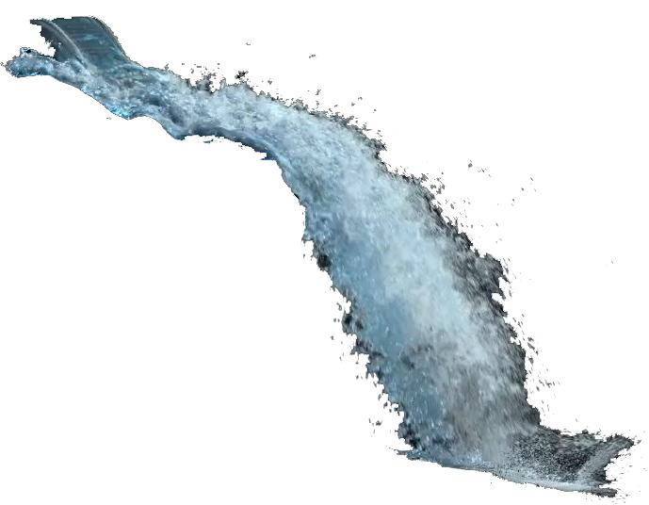
An Exploration of Optimisation Techniques for Particle Systems in Vulkan
Robin Wragg
Image: Yoshida, 2012
Notes:
My project is an exploration of optimization techniques for particle systems in Vulkan.
I’ll briefly introduce the components of this before getting more in-depth.

Slide 2
An Exploration of Optimisation Techniques for Particle Systems in Vulkan
Notes:
Let’s start with Vulkan. What does it do?

Slide 3
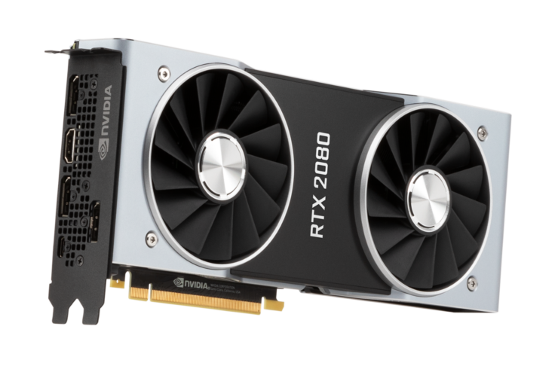

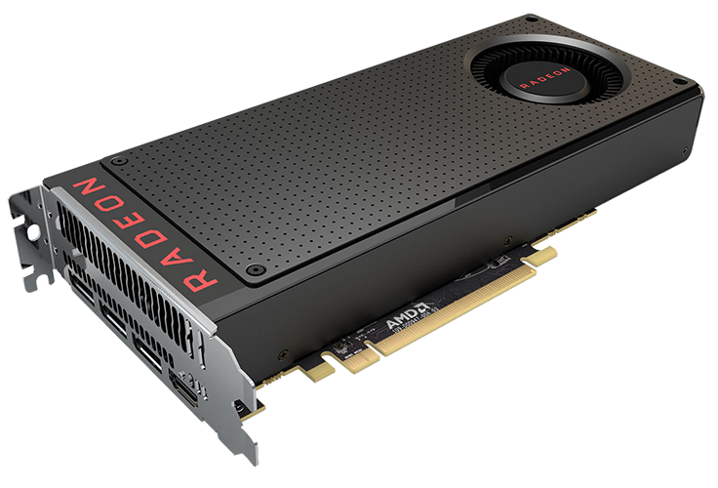

An Exploration of Optimisation Techniques for Particle Systems in Vulkan
?
Notes:
Consider this problem. We’re writing code that runs on the CPU, and we want to utilize lots of different graphics hardware. But we don’t want to have to write new code for every piece of hardware that we want to support. So how do we do it?

Slide 4




An Exploration of Optimisation Techniques for Particle Systems in Vulkan
Graphics APIs
Notes:
We use a graphics API. A graphics API is an Application Programming Interface for accessing the graphics hardware of a computer. The API exposes a common set of functions to our CPU code and the graphics hardware vendors, Nvidia, AMD and so on, write the hardware specific code. That way, we can say to the API, “put some triangles on the screen” and the hardware will know what to do.
Some of these APIs can only be used on certain platforms, which defeats the point a little bit, but I think graphics programmers generally are hoping Vulkan continues to gain adoption, as it’s currently the only fully cross-platform graphics API.

Slide 5
An Exploration of Optimisation Techniques for Particle Systems in Vulkan
Write once(ish), run anywhere
Notes:
Graphics programming is fun but complicated. The reason I wanted to learn Vulkan is because it provides more value than the others APIs.
Write once-ish run anywhere. We can talk about why it’s once-ish in the questions if you like.

Slide 6
An Exploration of Optimisation Techniques for Particle Systems in Vulkan
Iridesium, 2008
Notes:
Let’s move on to particle systems.

Slide 7
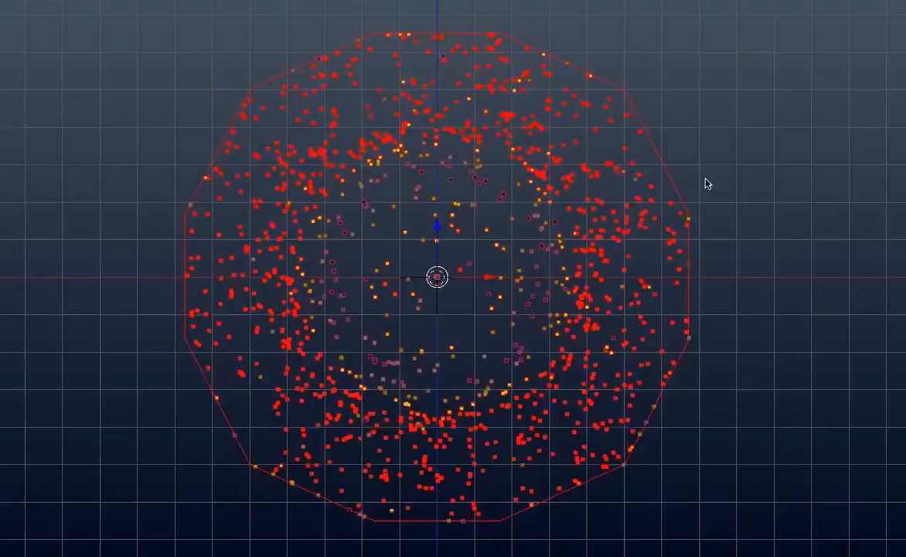
An Exploration of Optimisation Techniques for Particle Systems in Vulkan
Iridesium, 2008
Notes:
Here’s an example of one being built in Blender. Each of these dots is called a particle. You can see this person has made them spawn from the edge and move inwards.
Once you’ve got your particles moving the way you want, you can dress them up. You can make the particles look like raindrops or sparks or whatever you need, in order to make it look like your intended result.

Slide 8
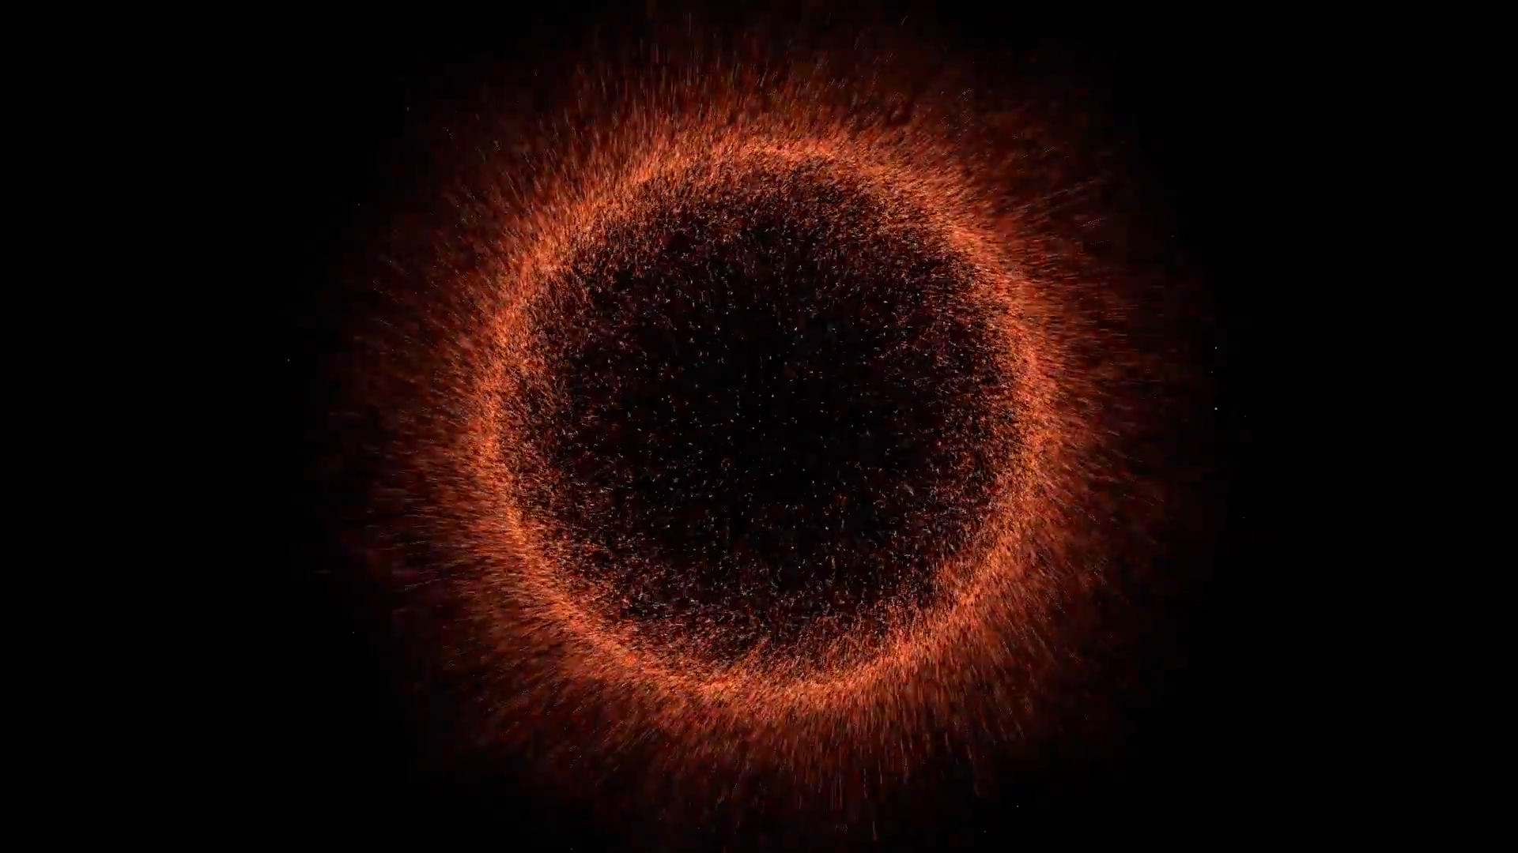
An Exploration of Optimisation Techniques for Particle Systems in Vulkan
Iridesium, 2008
Notes:
You can see that these particles were made to look like burning space matter, and that produced a kind of black-hole effect.

Slide 9
An Exploration of Optimisation Techniques for Particle Systems in Vulkan
Faster rendering
means more particles
means better effects
Iridesium, 2008
Notes:
Optimisation is valuable because the faster we can render, the more particles we can display, potentially improving the effect.

Slide 10
An Exploration of Optimisation Techniques for Particle Systems in Vulkan
Build a particle system in Vulkan and C++17
Research optimisation techniques for particle systems and Vulkan graphics pipelines
Validate the research via experimentation
Collect and analyse noteworthy techniques
Notes:
Optimisation is valuable because the faster we can render, the more particles we can display, potentially improving the effect.

Slide 11
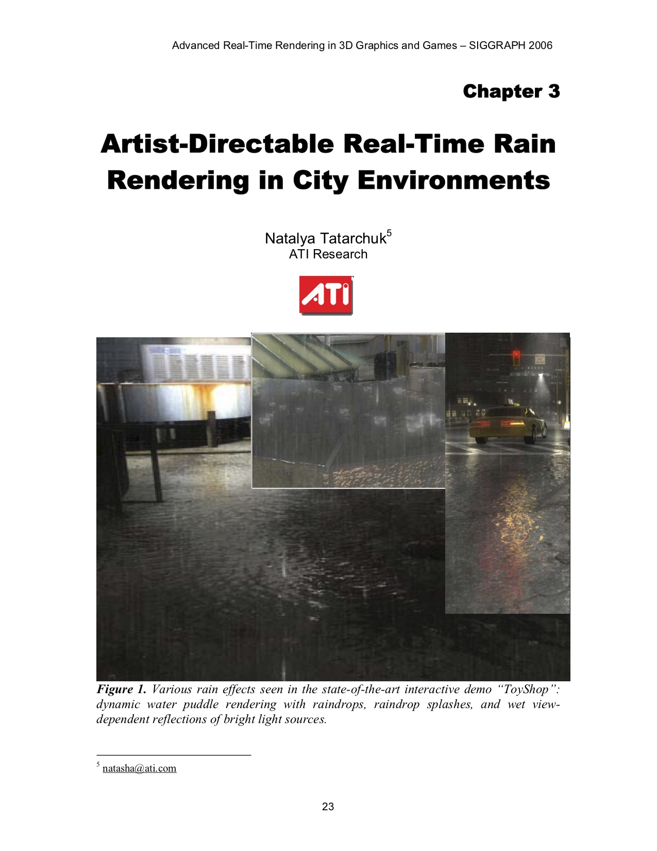
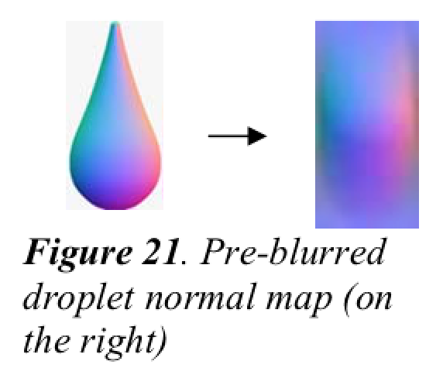
Notes:
Here’s my favourite paper so far; This is a comprehensive guide of how to render water in various states. The use of normal maps within the particle systems is particularly noteworthy.

Slide 12
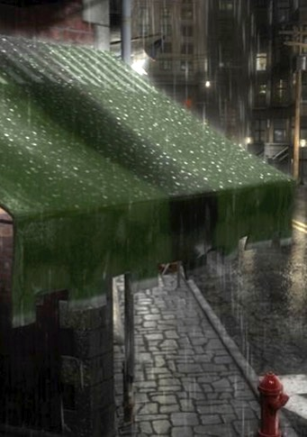
Notes:
Additionally, the dynamic droplets on the awning are very impressive for 2006!

Slide 13
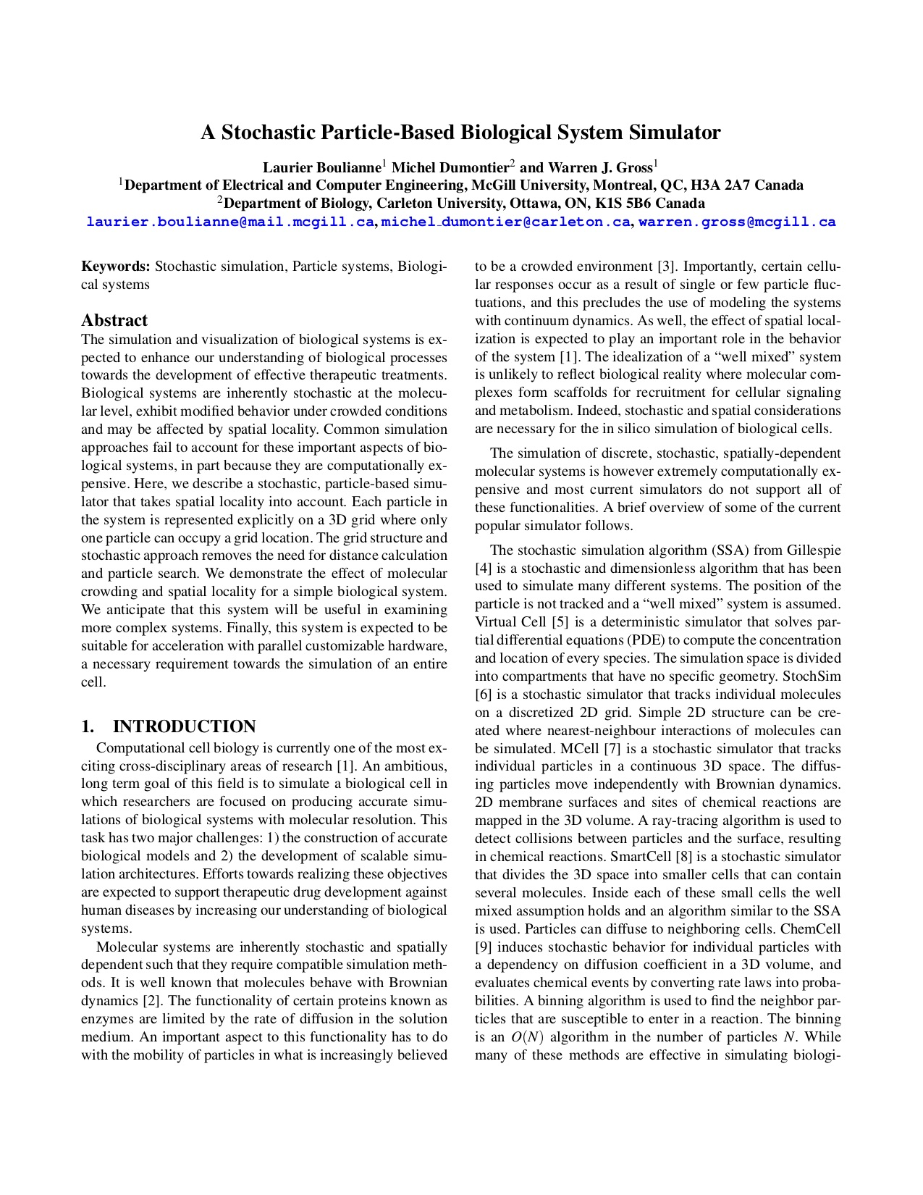
Notes:
You can find useful research in places you don’t expect. Here’s a paper for which a biological system simulator is built.

Slide 14
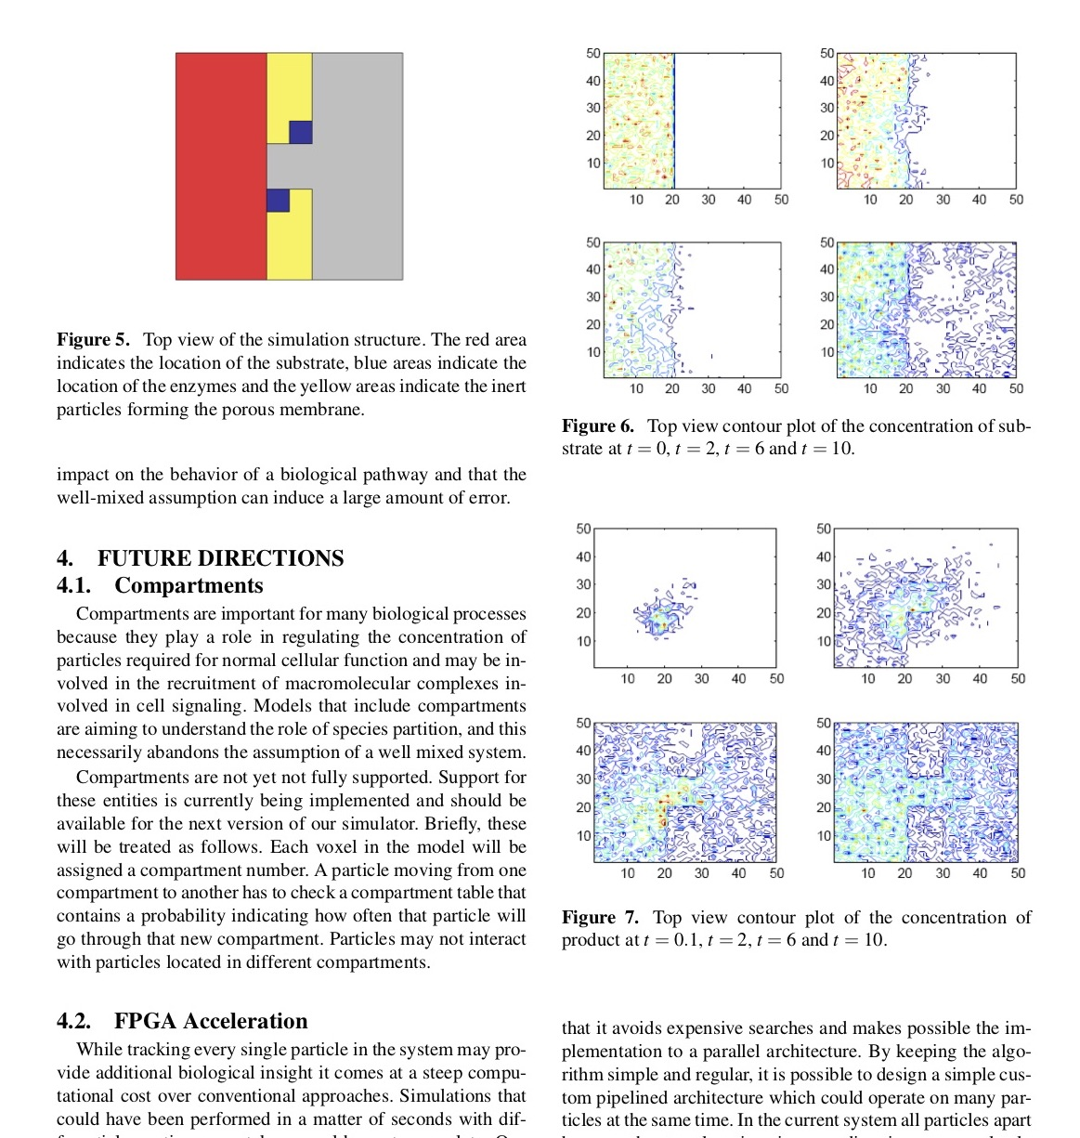
Notes:
Grid-based particle systems have performance advantages.

Slide 15
"This system is expected to be suitable for acceleration with parallel customizable hardware." (Boulianne, 2007)
Notes:
The paper even implies that this might run well on graphics hardware.

Slide 16
References
Boulianne, L., Dumontier, M. & Gross, W. J. (2007), ‘A stochastic particle-based biological system simulator’, Summer Computer Simulation Conference 2007.
Iridesium (2018), How to Make Sci-Fi Particle Effects in Blender. Available at https://www.youtube.com/watch?v=dMf-PHxSrho (Accessed: 15 October 2019).
Tatarchuk, N. (2006), ‘Artist-directable real-time rain rendering in city environments’, SIGGRAPH 2006.
Yoshida, T. (2012), Naiad Waterfall 01. Available at https://vimeo.com/50749116 (Accessed: 15 October 2019).

